Slide 1
School-Community Gardens
Overcoming Barriers
Kathryn Markham-Petro; Michelle Papineau and Marshall Bourque
Roseville School-Community Garden
https://www.facebook.com/groups/1577974662420080/

Slide 2

Benefits
Social inclusion at all levels
Place in the ecosystem
Raise awareness of agriculture
Notes:
me

Slide 3
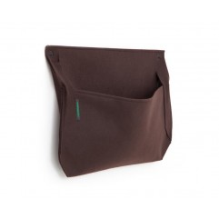
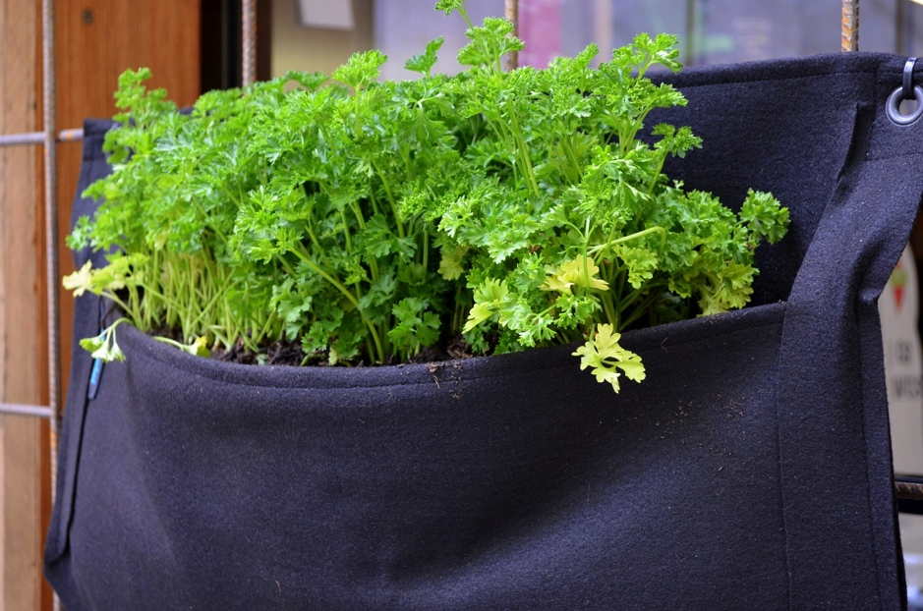
WoolyPocket
http://www.woollypocket.com/
Challenges?

Slide 4
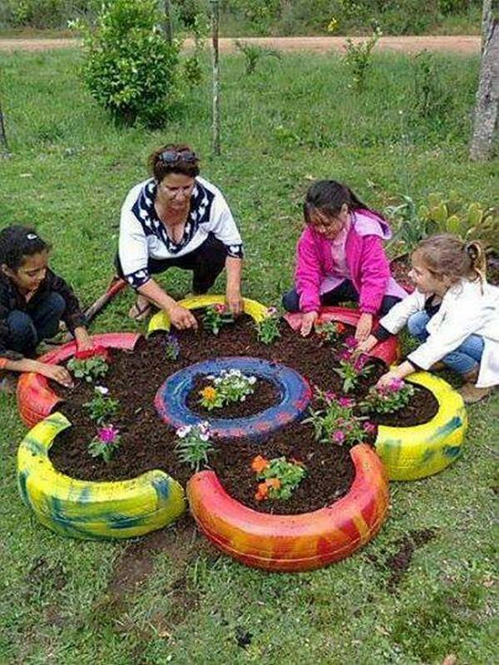
Challenges?
http://www.calrecycle.ca.gov/publications/Documents/Tires%5C62206013.pdf)
Preventing Playground Injuries, 2012, Canadian Pediatric Society. Retrieved from: http://www.cps.ca/documents/position/playground-injuries
Notes:
me

Slide 5
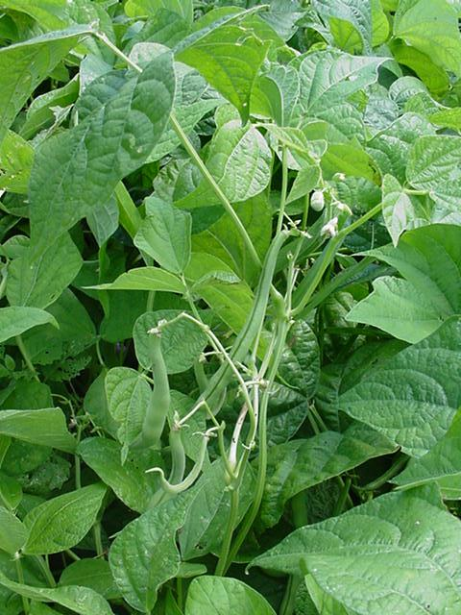
Challenges?
http://www.ontariopoisoncentre.com/ontariopoisoncentre/custom/plantSafety08.pdf
Notes:
me

Slide 6
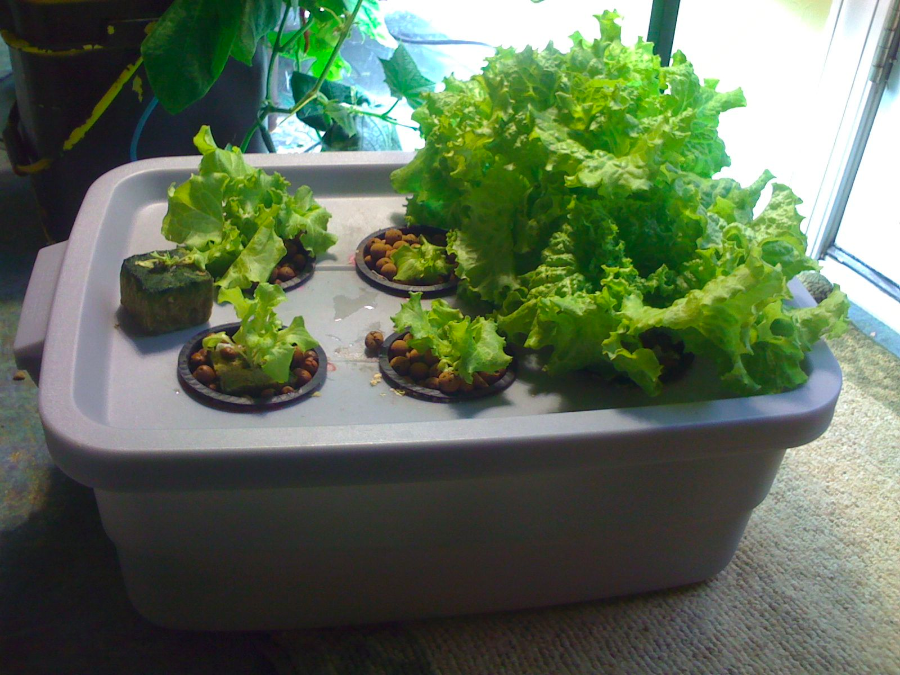
Our solutions!
http://manatee.ifas.ufl.edu/sustainability/hydroponics/Basic%20Hydroponic%20Systems%20and%20How%20They%20Work.pdf
Notes:
me

Slide 7
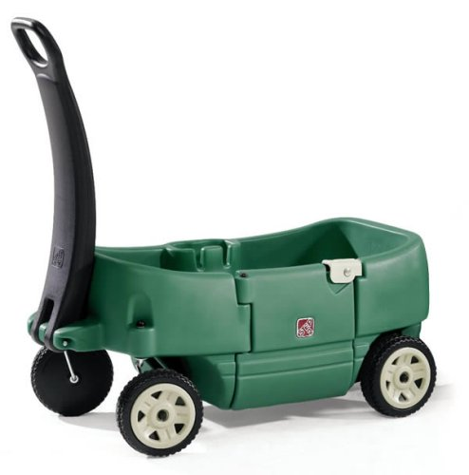
Our solutions!

Slide 8
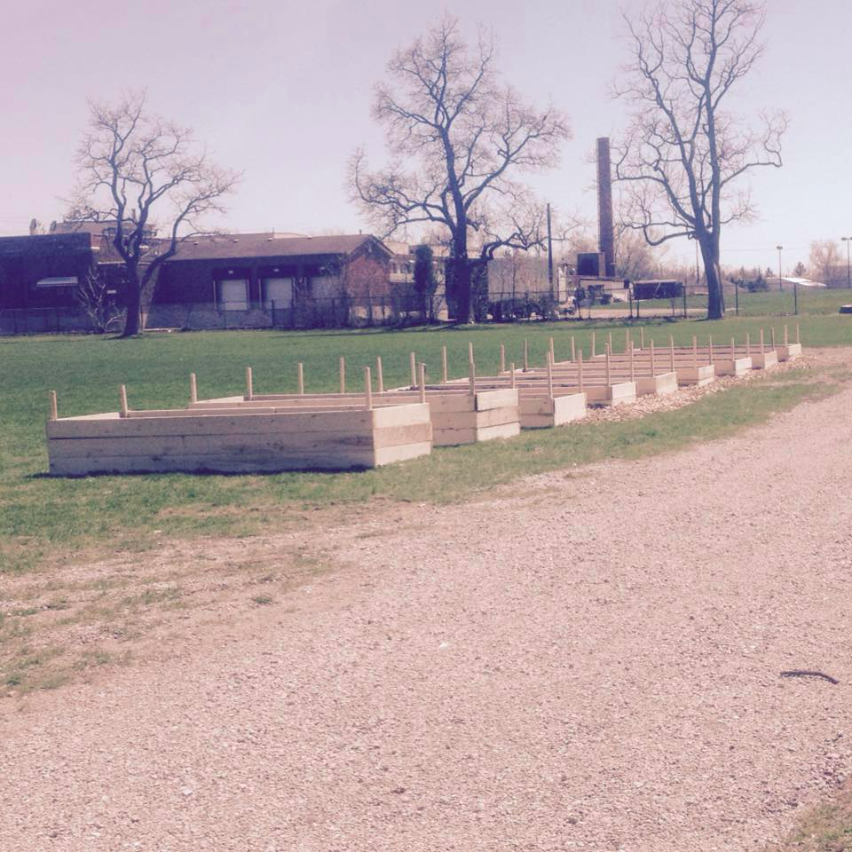
Our solutions!
http://www.kidsgrowing.ca/
Notes:
me

Slide 9
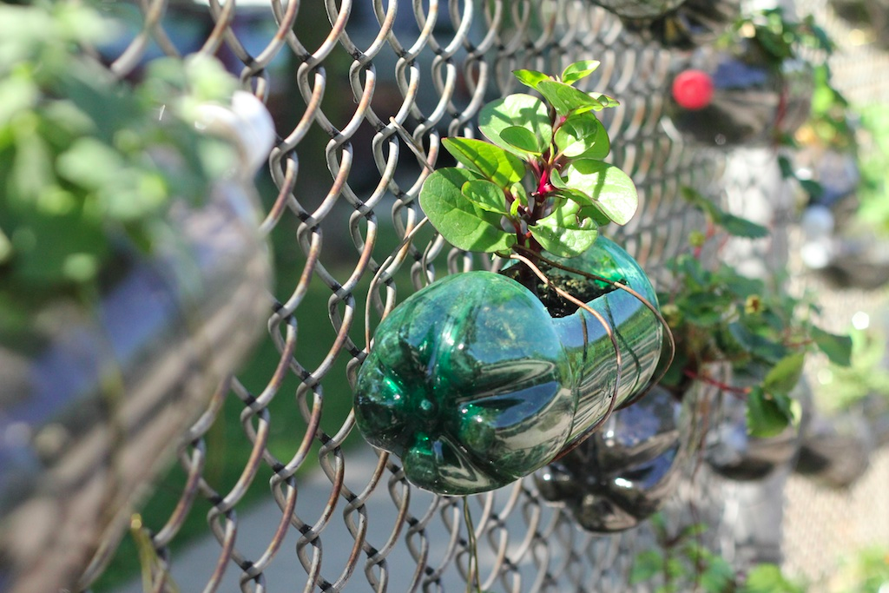
Our solutions!

Slide 10
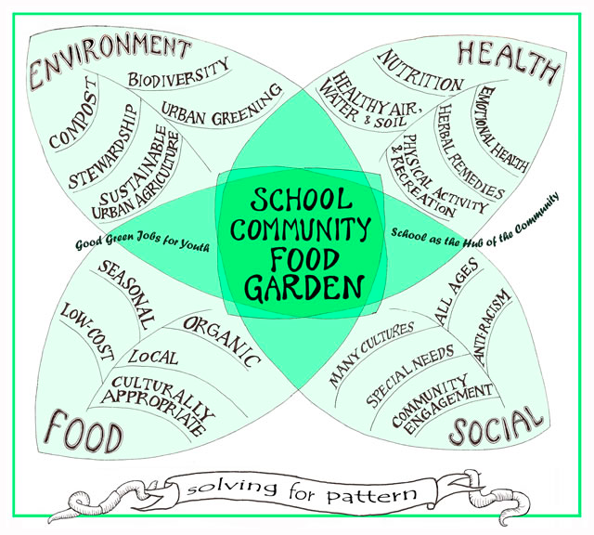
Thank you “A garden in every school”

