Slide 1
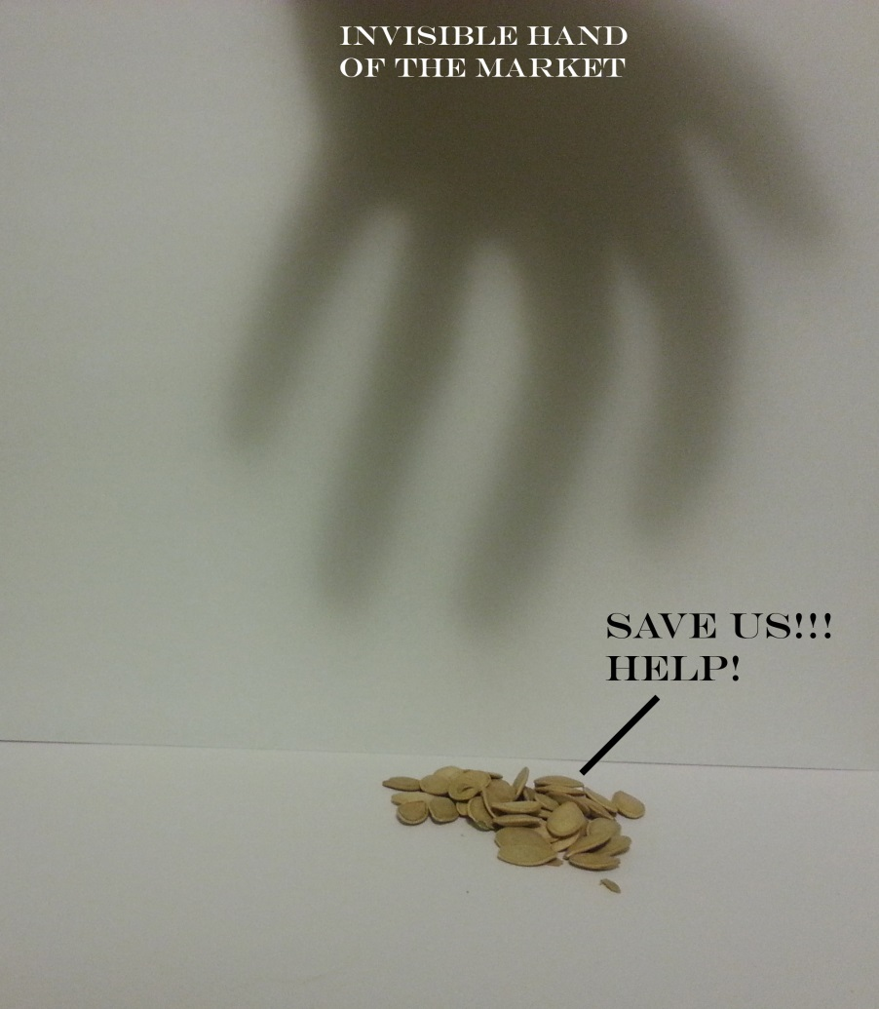
Why Save Seeds?
Preserve genetic & cultural diversity at the same time
Some plants dependent on humans
Economics & Self-sufficiency
Spirituality
Culture
Fun
Maintaining seed sovereignty and political reasons

Slide 2
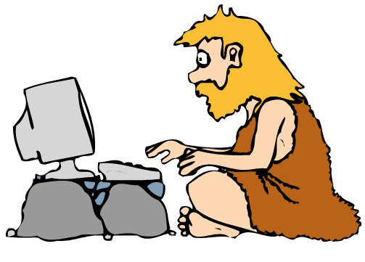
Background & History
“Seed Library” is a new name for an ancient practice
Term first appeared during the 90s
Alternate names: Community Seed Bank, Seed Vault, Seed Temple, Seed Sanctuary
Have “Gone Fungal” the last couple years

Slide 3
Seed Libraries Abroad & Networks
South Asian village-level Community Seed Banks/Libraries served as a large inspiration
Richmond Grows Seed Lending Library put together an amazing “Create Your Own Seed Lending Library” guide
Seed Social Network, also started by Richmond Grows
Europe is also getting in on the action!
Initial seeds planted in the Middle East and East Asia!

Slide 4
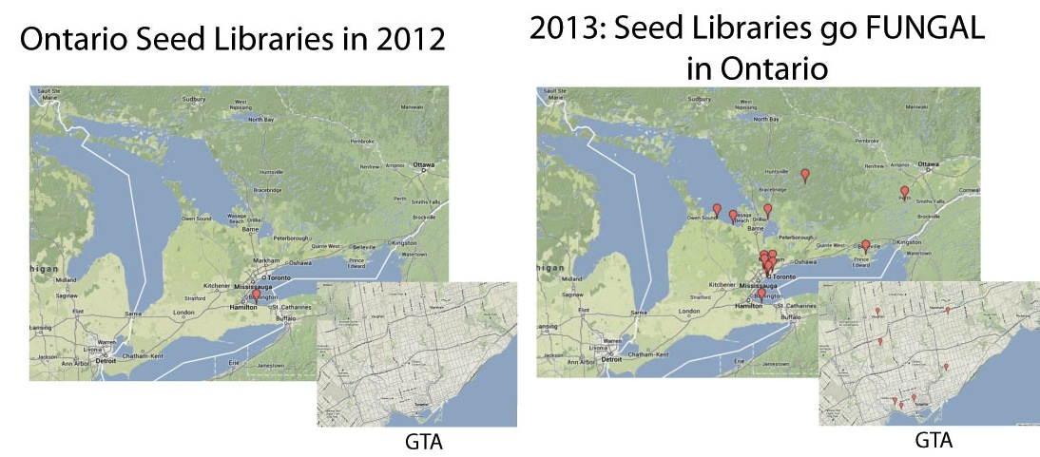
Fungal Growth of Seed Libraries in Ontario

Slide 5
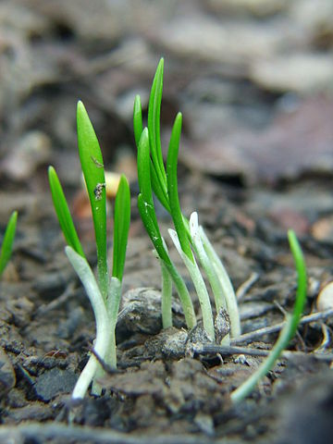
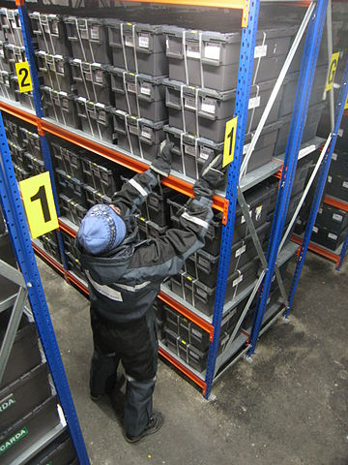
What’s difference with a Seed Bank?
Goals
Seed Banks play an important role and are focused on long term storage and are supported by central governments.
Seed Libraries’ primary goals are seed saving education & dissemination of seeds to as many people as possible.
THIS:
NOT THIS:
Methods
Seed Banks use cold storage and the latest technologies
Seed Libraries use simple storage techniques and traditional knowledge
Terminology
“Library” puts emphasis on the idea that seeds are a part of “The Commons.”
Uncomfortable with the word “bank”

Slide 6
Why a Seed Library?
Education: by spreading the knowledge resources to successfully grow and harvest food while saving seeds.
Revitalization: of health and communities. By meeting the growing need for seed, Seed Libraries increase access to healthy food and gardening has been shown to be beneficial for health.
Conservation: seed libraries preserve our traditional crops and culture by keeping them alive and growing a sustainable future.
Decolonization: by challenging seed patents (copyrighting life forms), monopolizing biotechnology companies, and industrial monoculture-style agriculture.
Regeneration: of seed saving, of concepts of the commons, reconnecting to where our food comes from and how it gets there, and rebuilding a relationship to the natural world that has been ruptured for many of us.

Slide 7
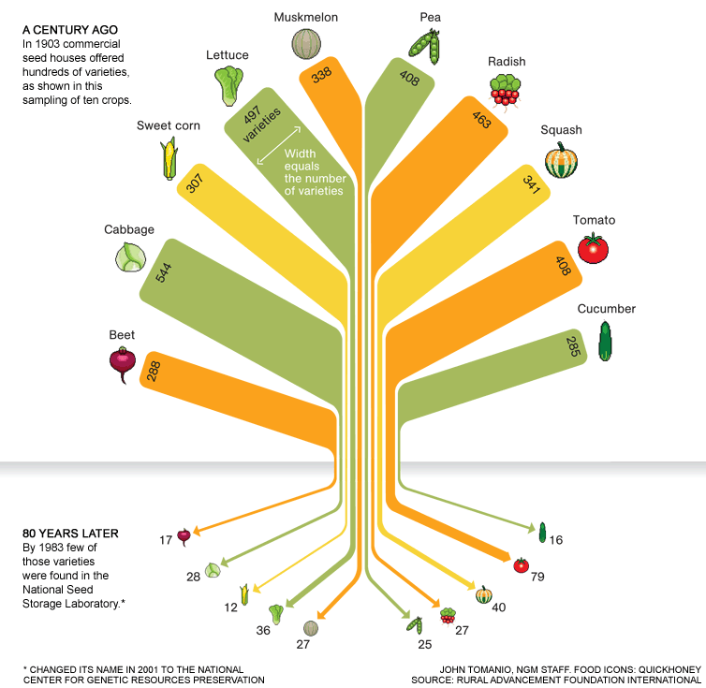

Slide 8
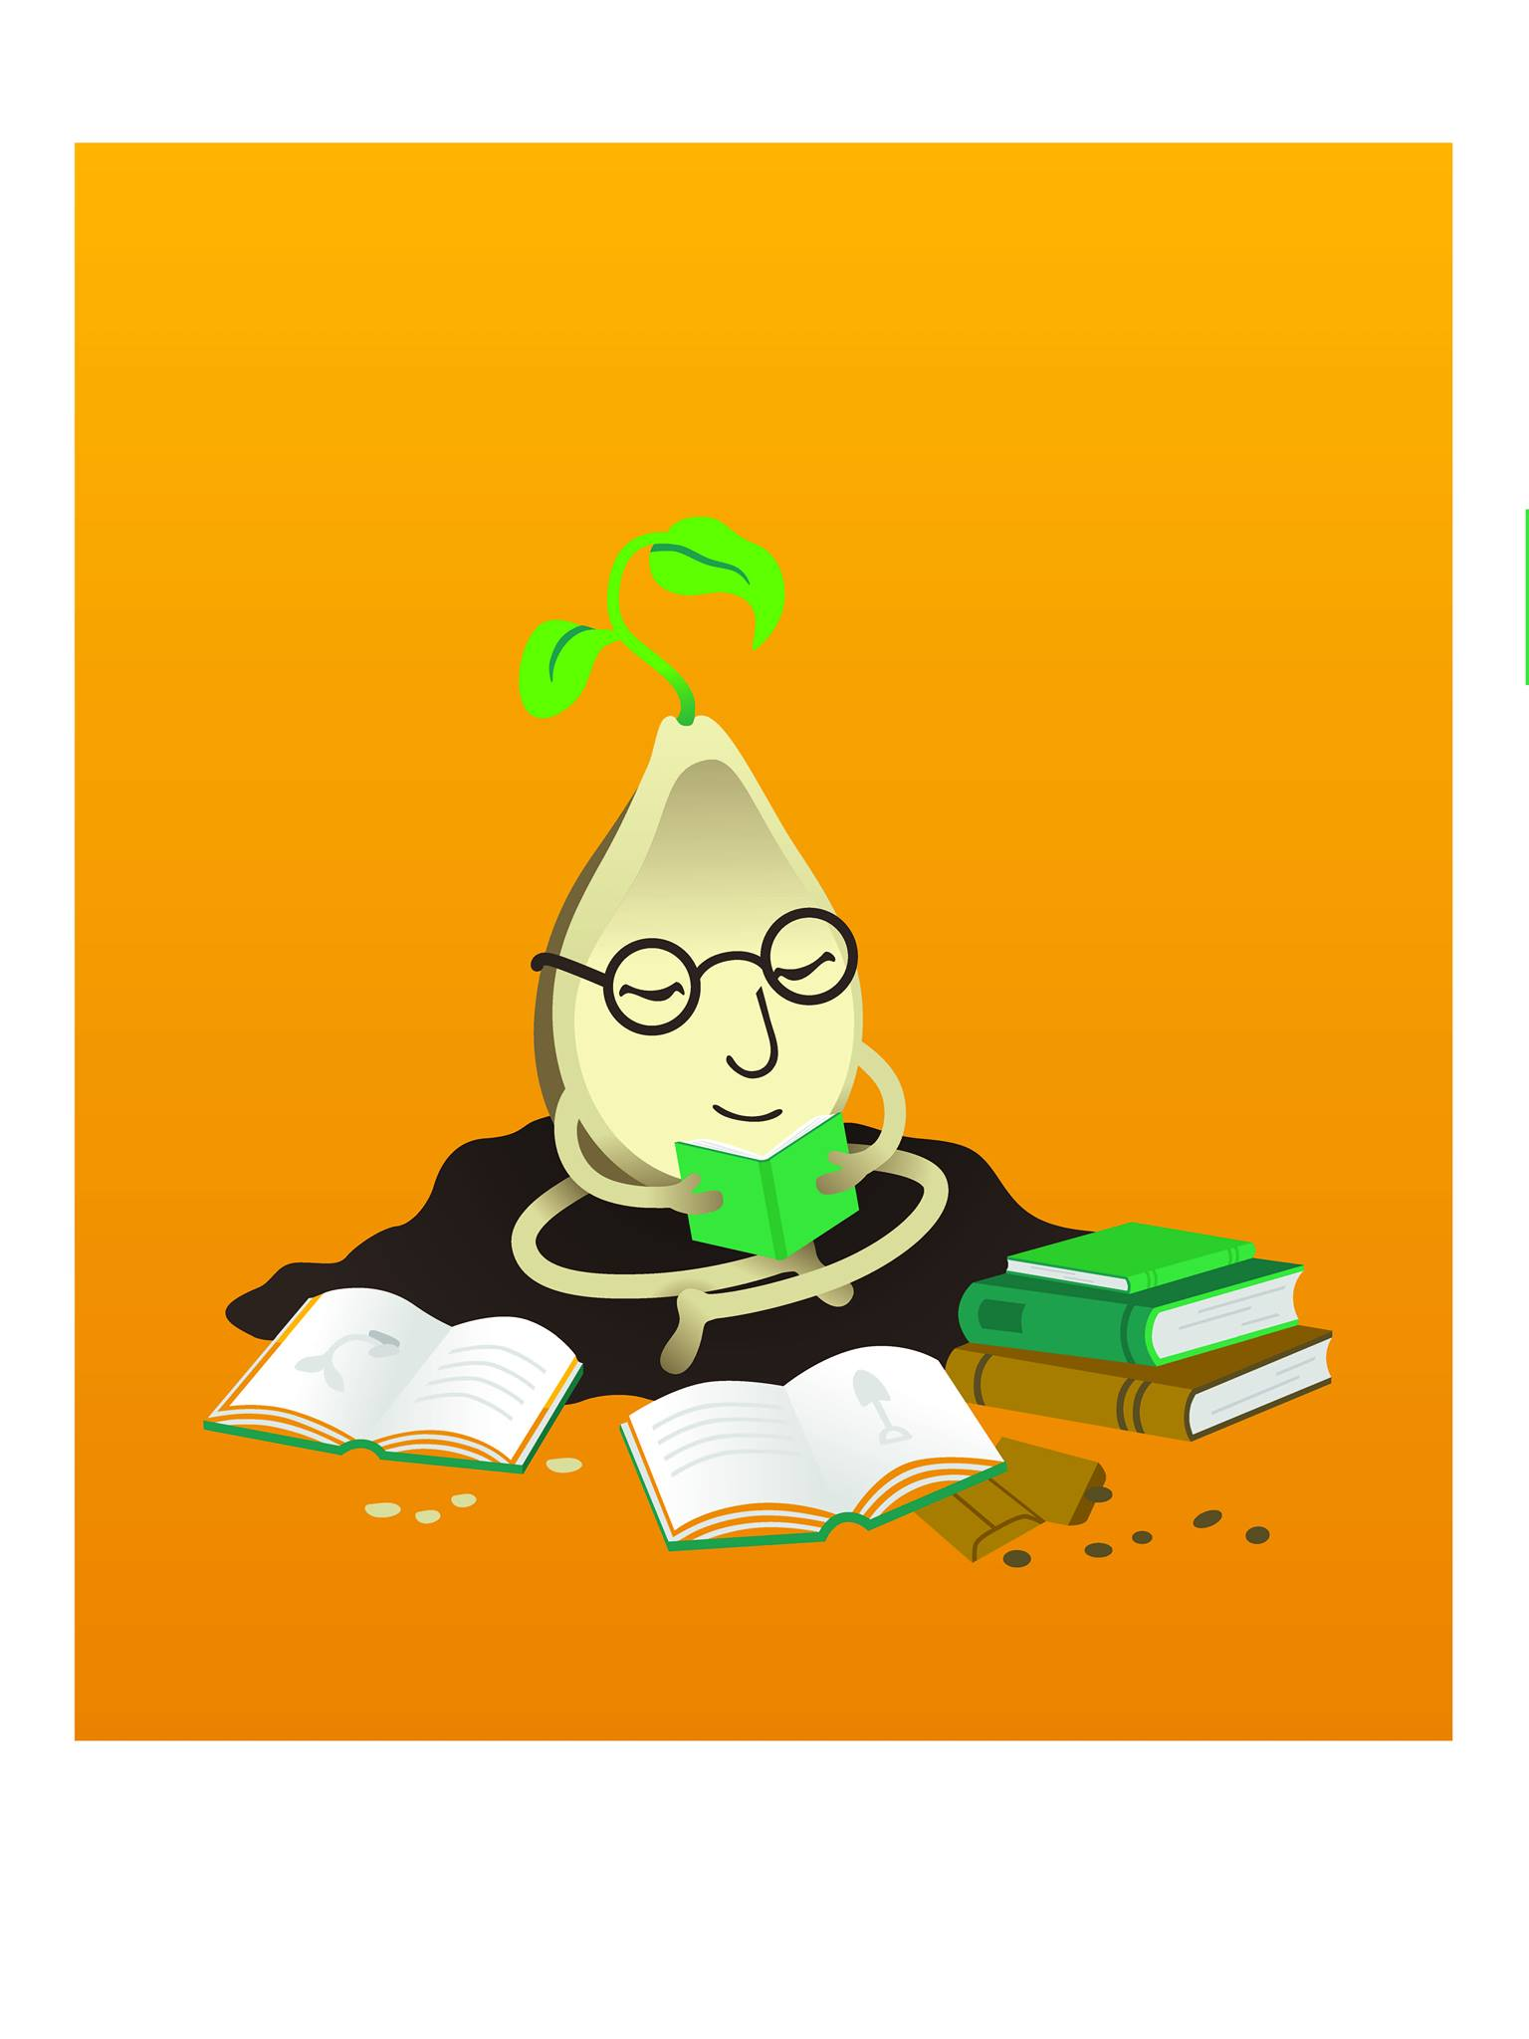
Seeds in the Library?
Expanding libraries beyond the book in the digital age
Libraries as places for reviving and rebuilding The Commons
Other examples: 3D printers in libraries, Tool Libraries, Kitchen Libraries, Human Libraries, Clothing Libraries

Slide 9
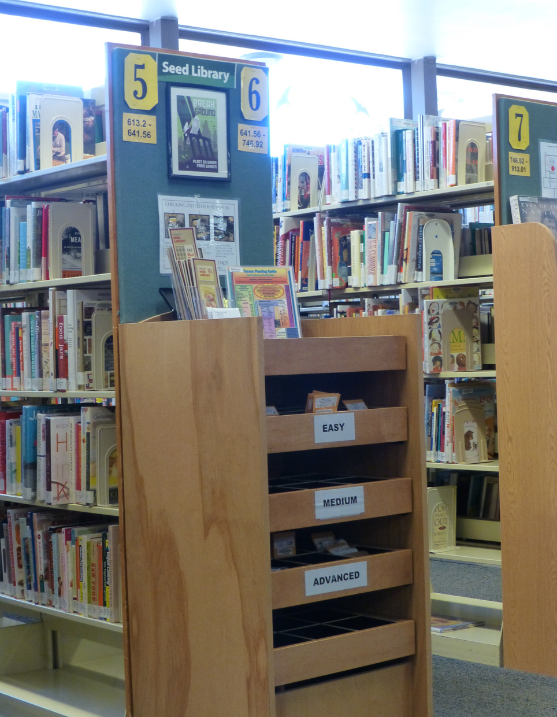
Who’s Involved? Where?
You, Me, Everybody!
Gardeners and Farmers
Everyone from experts to first-time growers
Window sills to community farms
Librarians & Libraries
Teachers & Schools
Community Leaders
Community Centres
Places of Faith (Seed Sanctuary)
Small Businesses & Co-ops
Pima County Seed Library

Slide 10
How to Sprout a Seed Library: The First Steps
Timing: now is the best time to start!
Launching: Soft Launch vs Big Launch
Growing the community:
Conservation Groups, Horticultural Clubs, Community Garden Groups, Seeds of Diversity Food Banks, Youth Groups, Transition Towns
Getting the word out & Building the Buzz
Local Media
Social Media & Blogging
Posters

Slide 11
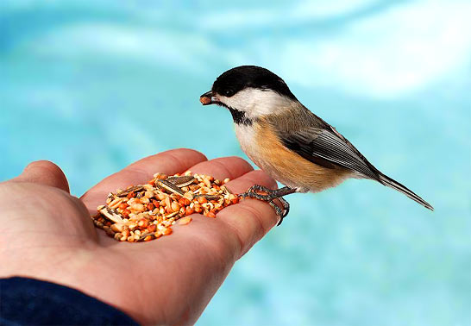
Getting the Seeds
Community Seasonal Seed Drives
Donations & Extras from Seed Farmers
2nd Harvest of Seeds
Seeds are generally still good past their sell-by date
Procure them from any place seeds are sold

Slide 12
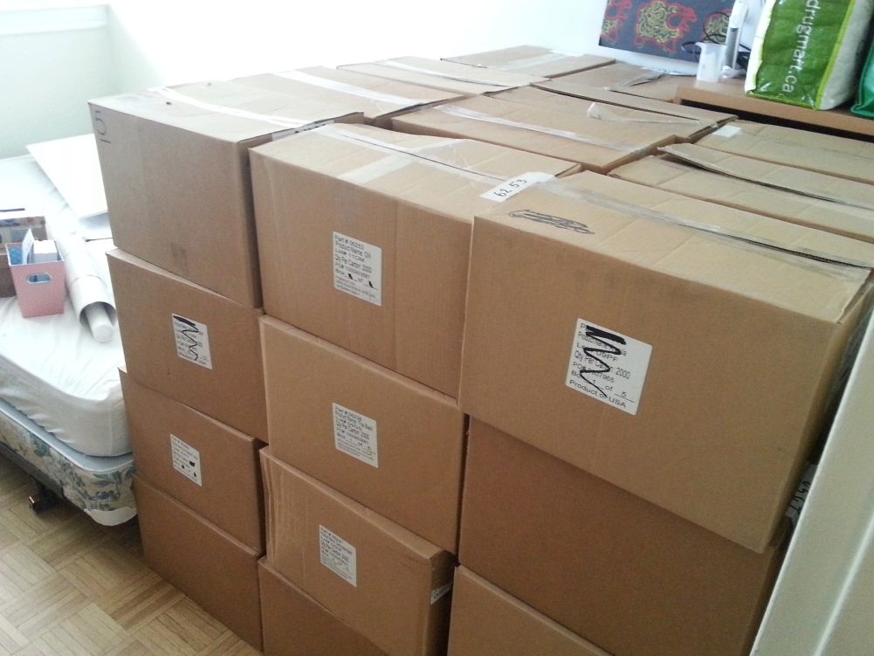
2nd Harvest Best Practices
Mark as *Not For Resale*
Follow companies’ instructions to ensure good working relationship
Eg: if they ask to keep their packaging, keep it! If they want you to repack, then repack!
2nd Harvest seeds are for rapid distribution
Truck load donated by Seeds of Change

Slide 13
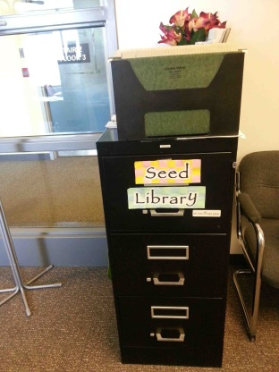
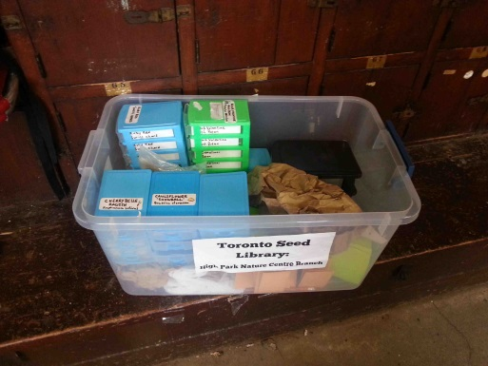
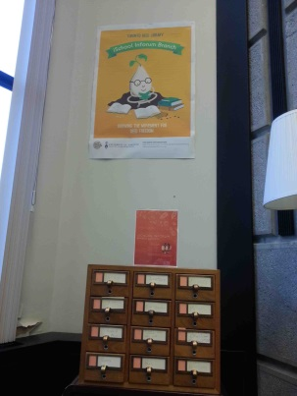
Seed Library Aesthetics
In what? Whatever works and fits your needs!
Shoe boxes, Old Card Catalogues, Filing Cabinets
High-traffic location
Permanent all season display
Signage in multiple areas
Next to or in the Gardening Book Section

Slide 14
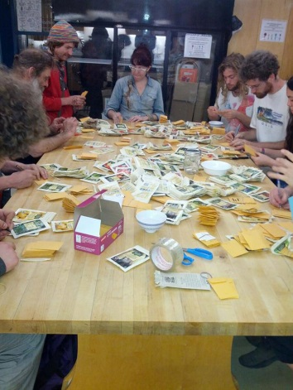
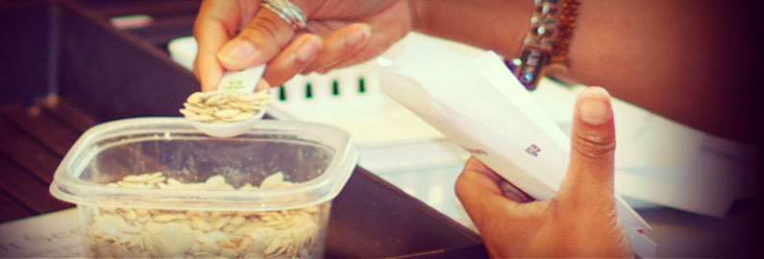
Replenishing Your Stock
Education is crucial!
Seed Saving Classes year round
Garden time in spring and summer
Hands-on Seed Saving during Harvest Season
Seed Cleaning & Packing Sessions to prepare for the “Spring Rush”
“Seeds Due” reminders

Slide 15
Classification Considerations
Ease of return (True to parent? Requires stratification? Wet seed?)
By Species? By Family? By Group?
It’s up to you!
Common vs Rare Seeds
Starting time
Early growers in March, Hardy crops in April, Frost Intolerant in May, Late crops July and August
By Age

Slide 16
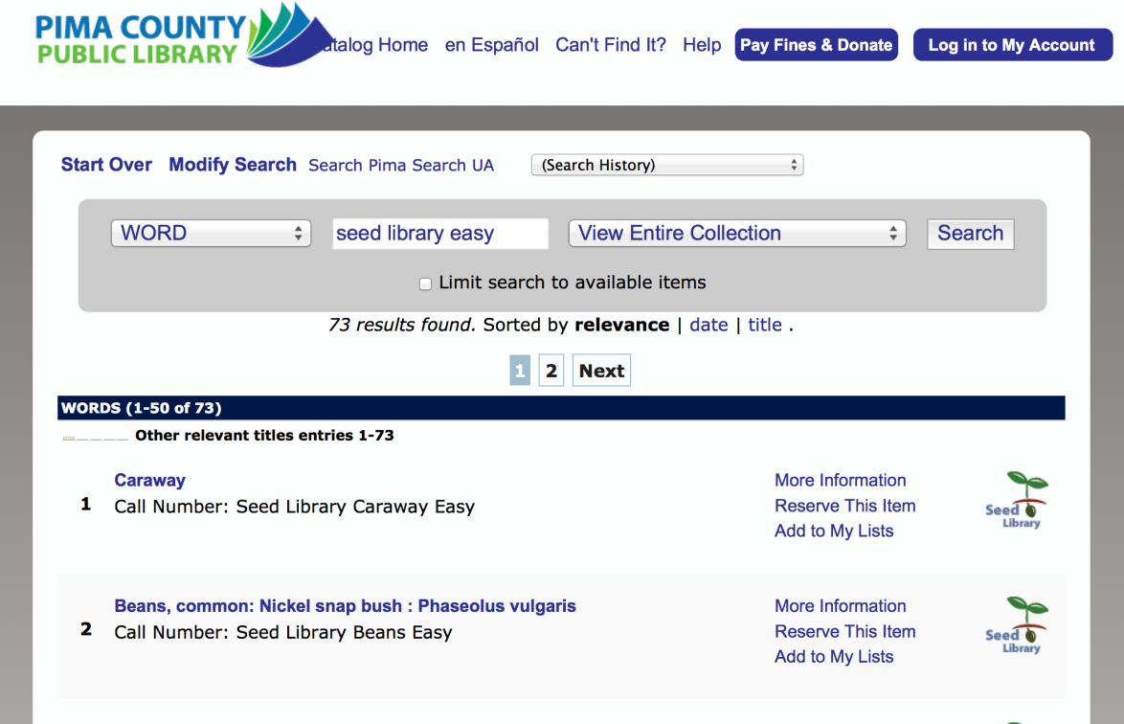
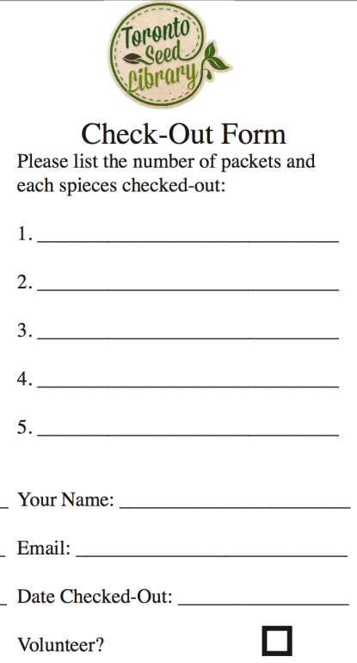
Cataloguing Considerations
Do it at all? Pure Honor System?
Integrate seeds into current system OR Create Optional System

Slide 17
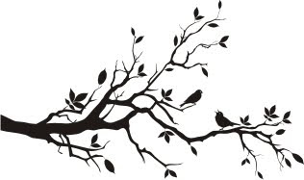
Multi-Branch Systems
Service demographically large cities and physically large regions
Examples: Tucson/Pima County & Toronto
Increases accessibility
Usually have a main location & several branches

Slide 18
Resources
Human
Financial
Staffing vs Self-Serve
Recommended to have a “How to Use” display
Locate near a staff person
At least one Expert Seed Saver needed to lead workshops
Small Upfront Cost
Launch Party, Seed Stock, Display
Low continued operating costs
Coin Envelops, Printing Resources, Honorariums
Funding through grants, fundraisers, magazine sales, and donation box
Some require paid membership

